Slide 1
The Principal; The Keystone of the School
Janet Ledesma, Ph.D.
Monday, August 6, 2012
(3:45 – 5:00 pm)
Session ID: 397
Location: Delta Island F

Slide 2
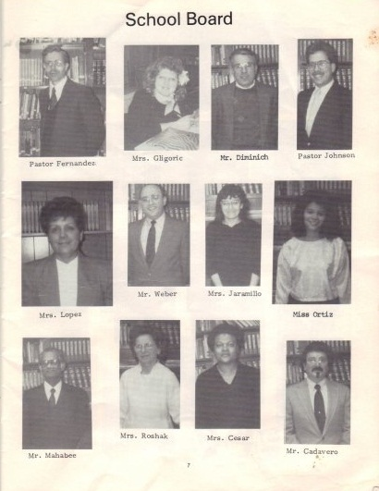
My First Principalship
Jackson Heights SDA School
1985

Slide 3
Reflection
Inexperienced
Lack of role clarity
From team member to Supervisor
Everyone knew how to do it better

Slide 4
The Role and Expectation of the Principal
Not clearly defined
“Self Taught”
Spiritual Intuition

Slide 5
Position Vacant: School Principal
Qualifications:
Wisdom of a sage,
Vision of a Chief Executive Officer,
Intellect of a scholar,
Leadership of a point guard,
Compassion of a counselor,
Moral strength of a nun,
Courage of a firefighter,
Craft knowledge of a surgeon,

Slide 6
Qualifications
Political savvy of a senator,
Toughness of a soldier,
Listening skills of a blind man,
Humility of a saint,
Collaborative skills of an entrepreneur,
Certitude of a civil rights activist,
Charisma of a stage performer,
and, Patience of Job.

Slide 7
Salary
Lower than you might expect.
Copland, M. (2001). The myth of the superprincipal.
Phi Delta Kappan, 82(7), 528-533.

Slide 8
The Complexities Associated with the Principalship
Political pressures and demands from constituency churches
School finance
Staffing
Lack of support
Lack of time to accomplish goals
Worshipping with parents and others within school community

Slide 9
Complexities
Work load and demands undoable
Conflict between personal and personal life
Decreased levels of job satisfaction

Slide 10
The Principalship
Vitally important
Primary responsibility; establishing school culture
Impact good happenings at the school
Single greatest impact on student performance
Direct correlation on student achievement and effective leadership

Slide 11
School Leadership that Works
Affirmation
Change Agent
Contingent Rewards
Communication
Culture
Discipline
Flexibility
Focus
9. Ideals/Beliefs
10. Input
11. Intellectual Stimulation
12. Involvement in Curriculum, Instruction, and Assessment
13. Knowledge of Curriculum, Instruction, and Assessment
14. Monitoring/
Evaluating

Slide 12
School Leadership that Works
15. Optimizer
16. Order
17. Outreach 18. Relationships
19. Resources
20. Situational Awareness
21. Visibility
Works Cited: Marzano, R. J. (2005). School Leadership that Works. Alexandria, VA: ASCD.

Slide 13
MUST READ

Slide 14
10 Most Essential Leadership Traits
Has a stated vision for the school and a plan to achieve that vision
Clearly stated goals and expectations for students, staff, and parents
Is visible; gets out of the office and is seen all over the school
Is trustworthy and straight with students and staff
Helps develop leadership skills in others,

Slide 15
10 Most Essential Leadership Traits Continued
6. Develops strong teachers; cultivates good teaching practice.
Shows that he or she is not in charge alone; involves others.
Has a sense of humor.
Is a role model for students and staff.
Offers meaningful kindnesses and kudos to staff and students
Hopkins, G. (2008). Principals identify top ten leadership traits. Education World. Retrieved from http://www.educationworld.com/a_admin/admin/admin190.shtml

Slide 16
Activity
Divide into groups of four

Slide 17
Discussion
How are you the Keystone of your School?
What areas will you focus on next school year?

Slide 18
Debriefing

Slide 19
Closing
I can do all this through him who gives me strength.
(Philippians 4:13 NIV)

