Slide 1
ABC's of Leading for the New Principal
Janet Ledesma, Ph.D.
Monday, August 6, 2012 (11:15 am - 12:30 pm)
Session ID: 298
Location: Delta Island E

Slide 2
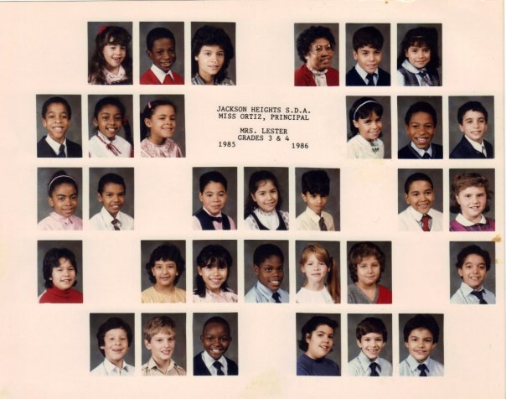
My Story

Slide 3
MUST READ

Slide 4
School Leadership that Works
Affirmation
Change Agent
Contingent Rewards
Communication
Culture
Discipline
Flexibility
Focus
9. Ideals/Beliefs
10. Input
11. Intellectual Stimulation
12. Involvement in Curriculum, Instruction, and Assessment
13. Knowledge of Curriculum, Instruction, and Assessment
14. Monitoring/
Evaluating

Slide 5
School Leadership that Works
15. Optimizer
16. Order
17. Outreach 18. Relationships
19. Resources
20. Situational Awareness
21. Visibility
Works Cited: Marzano, R. J. (2005). School Leadership that Works. Alexandria, VA: ASCD.

Slide 6
My Administrative Journey
Ruth Nino
John Chen
Brian Allison

Slide 7
Q&A

Slide 8
YOU have been Called
“Commit to the Lord Whatever you do & All of your plans will succeed”
(Proverbs 16:3 NIV)

